Slide 1

Tools for Electronically Exchanging Veteran Health Information
With Non-VA Partners
Glen Crandall,
VA VLER Health Direct Program Manager
Notes:
Thank you (JOE)! I am happy to be here today to talk health information exchange – specifically electronic health information exchange between the VA and our non-VA partners
We have been exchanging with DoD for years, but haven’t, until now, had a standard, electronic, secure method to share health information
I am going to talk about tools.
Tools include policies, processes, forms, and software to support health information exchange between the VA and our non-VA partners.
*******

Slide 2

Poll Question
What % of Veterans who receive VA healthcare also receive private sector healthcare?
  50 – 60%
  60 – 70%
  70 – 80%
  80 – 90%
Notes:
BLUE POLLING BUTTON

Slide 3


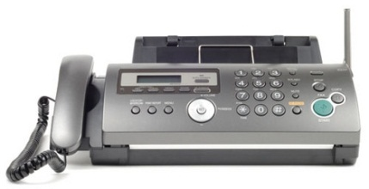
Exchanging Health Information
Notes:
Because most Veterans who receive VA care also receive non-VA care, there are significant opportunities to share health information.
Today most health information exchange happens through hand carrying, mailing, and faxing.
Or….

Slide 4
“…VA was transmitting sensitive data, including PII and internal network routing information, over an unencrypted telecommunications carrier network.”
“Without controls to encrypt the sensitive VA data transmitted, veterans’ information may be vulnerable to interception and misuse by malicious users as it traverses unencrypted telecommunications carrier networks.”
Notes:
Office of Inspector General (OIG) Report: Review of Alleged Transmission of Sensitive VA Data Over Internet Connections – 3/6/13
Personally Identifiable Information (PII)
Why is this being done?
No
*******

Slide 5

What Is
Missing?
Notes:
What’s missing?
The tools haven’t been available
That’s the focus on my presentation today—Tools for health information exchange

Slide 6

Poll Results
What % of Veterans who receive VA healthcare also receive private sector healthcare?
  50 – 60%
  60 – 70%
  70 – 80%
  80 – 90%
Notes:
Now let’s pause for a moment and take a look at your poll results.
Ad lib about the results
The correct answer is 70-80% - speak to that for a minute

Slide 7

Poll Results
What % of Veterans who receive VA healthcare also receive private sector healthcare?
  50 – 60%
  60 – 70%
  70 – 80%
  80 – 90%
Notes:
Now let’s pause for a moment and take a look at your poll results.
Ad lib about the results
The correct answer is 70-80% - speak to that for a minute

Slide 8

What Is VLER Health
Notes:
I have structured the presentation in an FAQ format.

Slide 9





The Virtual Lifetime Electronic Record (VLER)…
Administrative Information
& Medical Information
Notes:
VLER will allow health care providers access to Veterans’ and Servicemembers’ treatment records in a secure and authorized way, regardless of whether care is delivered in the private sector, at a military treatment facility, or at a VA medical center.
VLER Health supports the health information portion of VLER.
Not a system or database--uses many systems support the goal of access to a Veteran’s health information.
*******

Slide 10







Non-VA Provider
VLER Health Exchange
VLER Health Direct
Notes:
The VLER Health Program includes two primary tools for health information exchange:
VLER Health Exchange – allows VA and the non-VA provider to request and share Veterans’ health information from each other’s organizations
VLER Health Direct – allows one VA provider to send specific information to one non-VA provider (point to point) via email
These tools are different and complimentary methods of exchange
*******

Slide 11


More Robust
Trusted network
Query and retrieve methodology
Standards-based exchange
Exchange with other eHealth Exchange Members
eHealth Exchange
Point-to-point messaging
“Push” of clinical information using secure e-mail
Standard or non-structured notes and reports
Less Complex
Notes:
Both eHealth Exchange and Direct are national initiatives.
Both support health information exchange, but in different ways.
Exchange – Query and Retrieve – Pull
Direct – Push – secure email
*******

Slide 12

health information exchange (verb): the act of exchanging health information between two entities.
Health Information Exchange (HIE) (noun): An organization that supports exchange of health information in a region.
Non-VA Partner: An physician or organization outside of VA that provides or supports health care to Veterans.
Notes:
A few definitions to begin
We use health information exchange in 2 ways: as a verb and as a noun
A non-VA partner can be anyone outside of VA who facilitates health information exchange – doctor, clerk, HIE, technical partner
*******

Slide 13
Poll Question
What is your role at your VAMC?
Health Care Delivery (e.g., clinician, ancillary care)
Business/Administrative Support
IT/Privacy/Security
Health Records/Release of Information
Other

Slide 14

How can I use VLER Health?

Slide 15

Care Coordination
Continuity of Care
Referrals/Transitions of Care
Emergency Care
Fewer repeated tests/Cost savings
Notes:
VLER Health tools—Exchange and Direct—support clinical care of Veterans
RIGHT DATA to RIGHT PEOPLE at the RIGHT TIME improves Veteran care

Slide 16

What Is eHealth Exchange?
Notes:
I will now focus specifically on the eHealth Exchange or query and retrieve method for exchanging information.
First will talk about the eHealth Exchange at a national level.

Slide 17











eHealth Exchange
Health Bank or
PHR Support Organization
State and Local Gov
Community Health Centers
SSA
Community #1
Shared trust framework and rules of the road
VA
DoD
Labs
CMS
Integrated
Delivery System
Powered by
Pharmacies
Community #2
Notes:
eHealth Exchange formerly called NwHIN
Healtheway is a non-profit organization chartered to operationally support the eHealth Exchange
Currently
41 participants include four federal agencies, six states, and several dozen Health Information Organizations (HIOs) and health systems,
represent hundreds of hospitals
thousands of providers
millions of patients.
Healtheway DOES NOT maintain any data Healtheway IS NOT a gateway or connection point
*******

Slide 18

eHealth Exchange
Exchange with all
Digital Certificate
Connect
Onboarding/testing
DURSA
Notes:
All eHealth Exchange Participants
Abide by the Data Use and Reciprocal Support Agreement (DURSA) - Participants in the eHealth Exchange are bound by a trust agreement, to comply with these common “rules of the road”.
*******

Slide 19
Poll Results
What is your role at your VAMC?
Health Care Delivery (e.g., clinician, ancillary care)
Business/Administrative Support
IT/Privacy/Security
Health Records/Release of Information
Other

Slide 20

Poll Results
What is your role at your VAMC?
Health Care Delivery (e.g., clinician, ancillary care)
Business/Administrative Support
IT/Privacy/Security
Health Records/Release of Information
Other

Slide 21
What is VLER Health Exchange?
Notes:
Now VA participation in eHealth Exchange

Slide 22
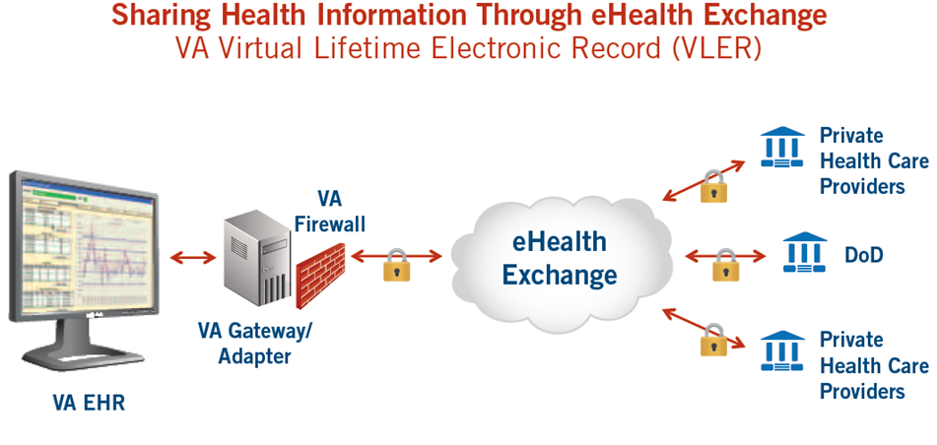
Notes:
Essentially the same process for the non-VA clinician
1. A Veteran presents to the VA for an appointment.
2. A VA clinician accesses the Veteran’s electronic health record and when looking at remote data in VistAWeb, the clinician sees that the Veteran has non-VA data available.
3. Real-time query and retrieve of electronic health information from any participating eHealth Exchange partners
Where the Veteran is known and their identity has been matched between the VA and the private partner. This is what is referred to as establishing a patient correlation.
4. Any information that is available is then presented to the clinician as view only from within VistAWeb.
*******

Slide 23

What are the benefits of VLER Health Exchange to Clinicians?

Slide 24

Care coordination
More informed decisions
Population health management
  Immediate access
  Patient safety
Notes:
When a clinician has access to more of a Veterans health information from outside sources
Improves care coordination
Enables clinicians to make more informed decisions
Provides immediate access to additional health care information during an emergency
Supports Population Health Management
Increases patient safety (e.g., medication reconciliation)
*******

Slide 25
What are the benefits of VLER Health Exchange to Veterans?

Slide 26


Reduces the need for Veterans to carry paper records between health care providers
Decreases test/service
Expedites results notifications
Enhances security and privacy
Improves Veteran care and health outcomes
duplication
Notes:
Reduces the need for Veterans to carry paper records between health care providers
Decreases test/service
Expedites results notifications
Enhances security and privacy
Improves Veteran care and health outcomes
*******

Slide 27

What does a Veteran need to do to authorize to share their data with non-VA partners?
Notes:
It’s easy to see the value of VLER Health Exchange
But, it doesn’t come without effort from VA staff

Slide 28
VLER Health Authorizations
VA
ALWAYS required
Non-VA Partner
SOMETIMES required
Notes:
VA Authorizations: Required for all Veterans before VA will disclose a Veteran’s information to a non-VA partner
Non-VA Partner Authorizations: Some, but not all, non-VA organizations require a patient authorization prior to sharing health information.
By policy, the VA must obtain the Veteran’s authorization to disclose health information pertaining to Title 38 USC 7332-protected conditions,
drug and alcohol abuse
HIV testing or infection
sickle cell anemia
No way to filter from the patient record
Depending on VAMC site, signed authorization forms may be received through
the mail
in person
or a combination of both
Or, Veterans can submit them electronically through the eBenefits online portal.
Authorization good for 5 years
Private partners may or may not require a separate authorization form before they disclose information to the VA, depending on their organizational policies and state regulations.
Veteran can change their mind and opt out
*******

Slide 29
What are the steps for implementing VLER Health Exchange at my facility?
Notes:
Note Previous My VeHU Session
VeHU Session #14033- “Privacy and Release of Information within VA Electronic Health Information Exchange” presented by Jennifer Teal and Peggy Pugh

Slide 30

VAHCS Roles and Responsibilities
Notes:
Before we define the steps, let’s discuss roles.
Would define in notes
VLER Lead- point of contact for the VAMC, the National VLER Health Team and, depending on site, all local community partners.
IT staff- Although most of the eHealth Exchange technical solution is centrally implemented, VAMC staff Provide a point of contact for coordination of efforts between IT groups
My HealtheVet Coordinator- Conduct patient outreach for My HealtheVet and VLER Health Exchange
VAMC/VISN leadership- act as the regional sponsor for the project and ensure that the VAMC Facility staff is on board and have the resources to support the project
Clinicians
Clinical Leaders/Champions???- involved more closely with the local VLER Health implementation plan than the larger end-user community and will assist in determining targeted super-users and training initiatives. They will provide feedback to and from providers regarding usability, data quality and desired enhancements.
HIM- the primary responsibility for managing disclosures and entry of authorizations into the Veterans Authorizations & Preferences (VAP) system
Privacy Officer- ensure that privacy policies and processes are maintained throughout the program
Public Relations/Public Affairs Officer/Staff - coordinate with the VISN and National Communication and Public Relations groups
*******

Slide 31

Who are
ommunity Coordinators onand how can they
help me?
Notes:
There are many pieces to successfully implementing Exchange at a site.
Community Coordinators help bring the pieces together.
12 Regional Coordinators
55 RHCC
*******

Slide 32

Training and Education
Veteran Recruitment
Facility Communication Support
Software Access
Notes:
Training and education for VAMC staff, Veterans, and community Exchange non-VA partners
Veteran recruitment and authorization assistance
Support facility communication efforts
Assist with VLER Health Exchange software access
*******

Slide 33
Implementation Life Cycle
Build Team, Initiate Process
Define Enrollment Strategy
Marketing VLER Health to Veterans
Role of ROI in VLER Health
Clinician Training
Troubleshooting, Management Reporting & Sustainment

Slide 34
Implementation Life Cycle
Build Team, Initiate Process
Define Enrollment Strategy
Marketing VLER Health to Veterans
Role of ROI in VLER Health
Clinician Training
Build Team, Initiate Process
Troubleshooting, Management Reporting & Sustainment
Notes:
Phase 1: Build Team, Initiate Process

Slide 35
Implementation Life Cycle
Build Team, Initiate Process
Define Enrollment Strategy
Marketing VLER Health to Veterans
Role of ROI in VLER Health
Clinician Training
Troubleshooting, Management Reporting & Sustainment
Define Enrollment Strategy
Notes:
Phase 2: Define Enrollment Strategy
Some sites have used mailers, table in the lobby.
Effective if clinicians are involved in education of Veterans

Slide 36
Implementation Life Cycle
Build Team, Initiate Process
Define Enrollment Strategy
Marketing VLER Health to Veterans
Role of ROI in VLER Health
Clinician Training
Marketing VLER Health
to Veterans
Troubleshooting, Management Reporting & Sustainment
Notes:
Phase 3: Marketing VLER Health to Veterans
Providing Veterans with tools

Slide 37
Implementation Life Cycle
Build Team, Initiate Process
Define Enrollment Strategy
Marketing VLER Health to Veterans
Role of ROI in VLER Health
Clinician Training
Troubleshooting, Management Reporting & Sustainment
Role of ROI in VLER Health
Notes:
Phase 4: The Role of Release of Information Office in VLER Health

Slide 38
Implementation Life Cycle
Build Team, Initiate Process
Define Enrollment Strategy
Marketing VLER Health to Veterans
Role of ROI in VLER Health
Clinician Training
Troubleshooting, Management Reporting & Sustainment
Clinician Training
Notes:
Phase 5: Clinician Training

Slide 39
Implementation Life Cycle
Build Team, Initiate Process
Define Enrollment Strategy
Marketing VLER Health to Veterans
Role of ROI in VLER Health
Clinician Training
Troubleshooting, Management Reporting & Sustainment
Troubleshooting, Management Reporting & Sustainment
Notes:
Phase 6: Troubleshooting, Management Reporting & Ongoing Support
Increase usage

Slide 40

What tools are used to help a Veteran get authorized to share their data?
Notes:
2 tools – 1 for VA staff and 1 for Veterans

Slide 41

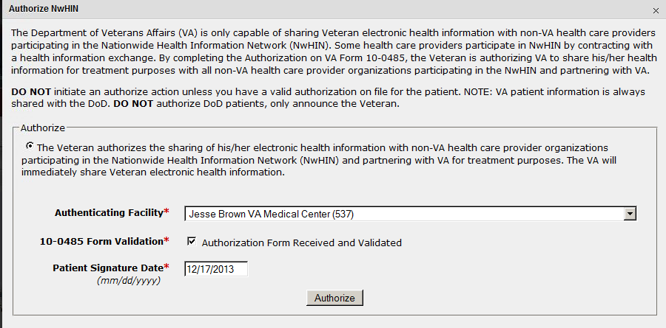
VA Form 10-0485: Authorize
VA Form 10-0484: Revoke
Notes:
1st software tool: Veteran’s Authorization & Preferences (VAP)
Signing form and entering in VAP changes to opt in status
This authorization covers these protected conditions that the patient may have upon signing of the authorization as well the diagnoses that may be acquired in the future for as long as the authorization is valid.
Only a few at VAMC have access to VAP
*******

Slide 42
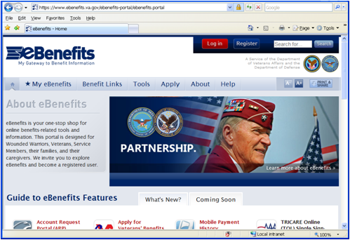
Management
of Patient Preferences
Notes:
This is one option available for Veterans to manage their eHealth Exchange consent directives.
Veterans that currently have a “Premium” account in eBenefits,
can electronically sign and submit the eHealth Exchange authorizations, revocations, and restriction forms.
Adds convenience to the Veteran and reduces the work of the Release of Information (ROI) staff at the medical center
*******

Slide 43

What tool can I use to view non-VA
Veteran health information?
Notes:
Software tools

Slide 44

Accessing Non-VA Data in VistAWeb
1
In CPRS, click the VistaWeb button to view remote data
VistaWeb
Notes:
1. In CPRS, click the VistaWeb button to view remote data

Slide 45
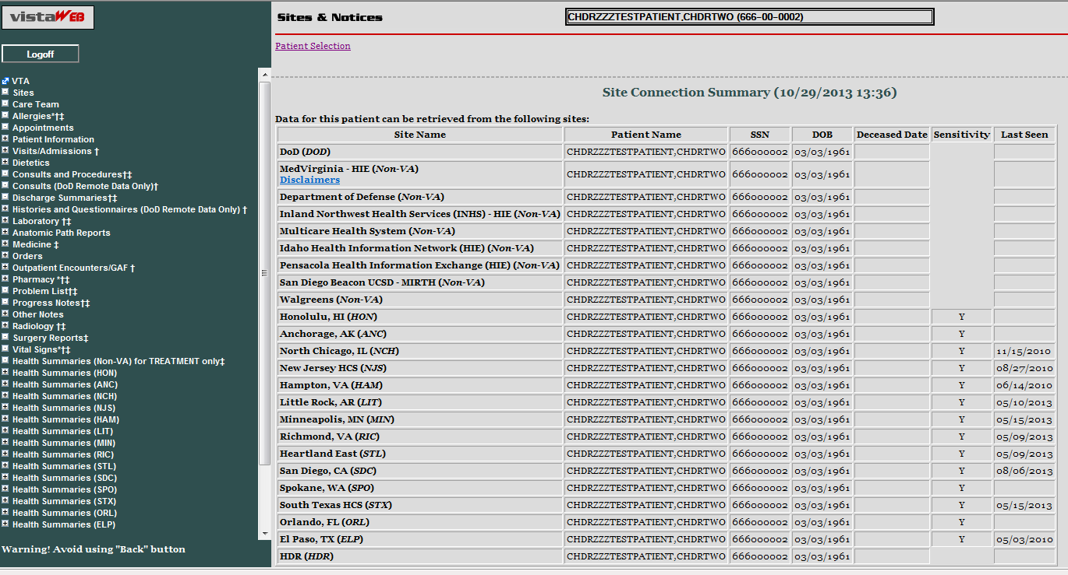
Pocket Card – Accessing Non-VA Data in VistAWeb
2
See the
Sites & Notices screen for a list of all data sources

Slide 46
Pocket Card – Accessing Non-VA Data in VistAWeb
3
Click on
Health Summaries (Non-VA) for TREATMENT only to request data from non-VA providers

Slide 47
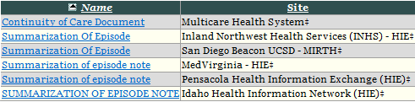
Pocket Card – Accessing Non-VA Data in VistAWeb
4
Click on the Summary of Care document you wish to view

Slide 48
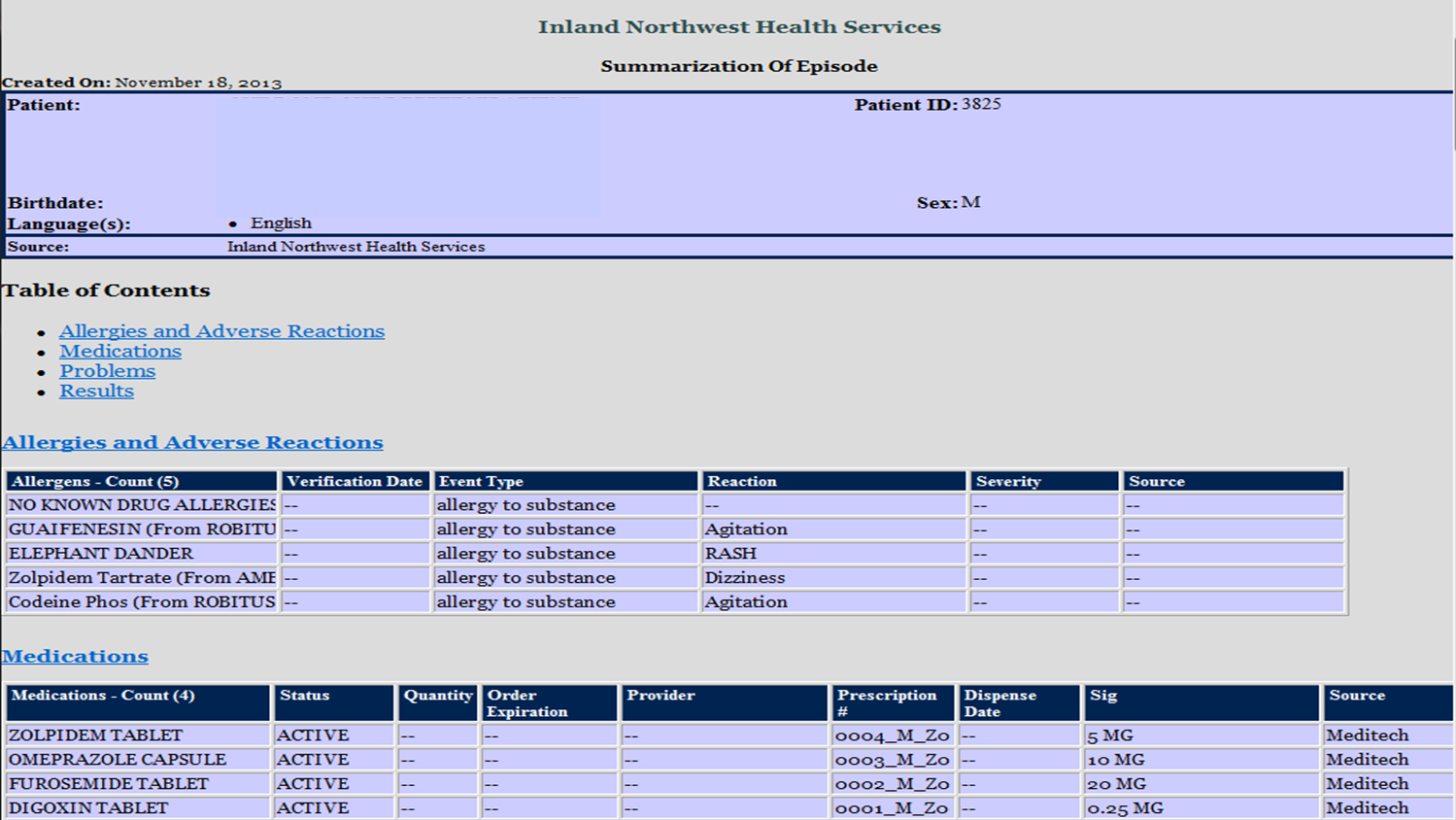
VistAWeb View of
Non-VA Health Summary
Notes:
Structured Data

Slide 49
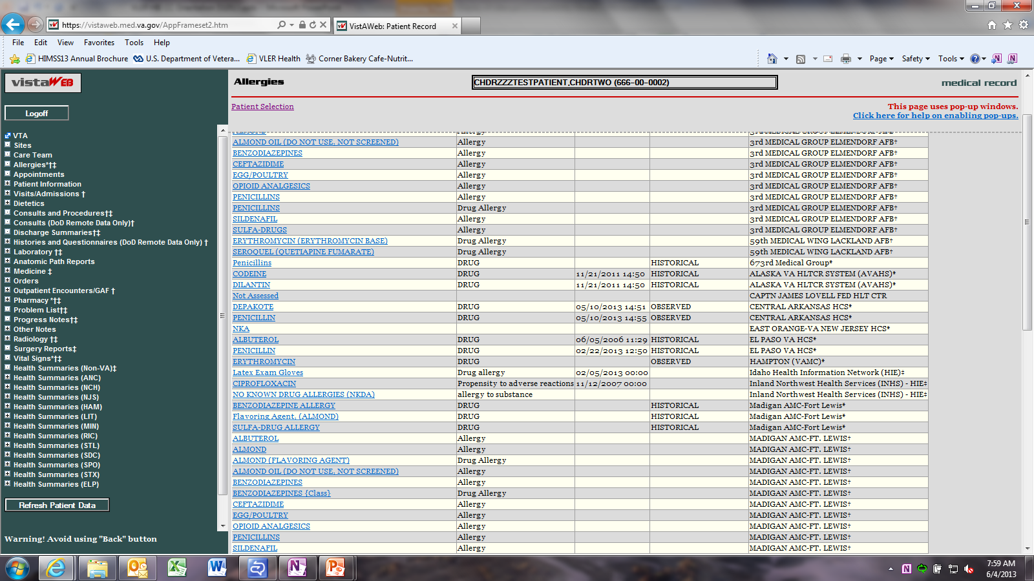
VistAWeb View of Aggregated Allergies
Notes:
Shows all VA, DoD and non-VA allergies together
First step in using non-VA data in supporting additional Decision Support

Slide 50


Any VA clinician…
…at any VA facility
Notes:
You don’t have to work at a VA facility that is actively recruiting Veterans in order to use VLER Health Exchange…
Any VA clinician can access non-VA health care information using VistAWeb as long as the information is available.
Example – a Veteran from Indianapolis who spends winters in Florida – the Florida doctor could access non-VA Indianapolis records
*******

Slide 51
What Veteran health information is shared using VLER Health Exchange?

Slide 52
VA Health Summary (C32)
  Personal Information
  Language Spoken
  Support (contact Info)
  Healthcare Provider
  Allergy/Drug Sensitivities
  Conditions/Problems
  Medications
  Information Source (document level)
  Comment
  Immunizations
  Vital Sign
  Results (Chemistry and Hematology)
  Encounters
  Procedures
VLER Health Exchange populates 14 sections of the C32 Summary of Care clinical document

Slide 53
VA Clinical Notes (C62s)
  Consults/Referrals
  Discharge Summaries
  History and Physicals
  Results of Diagnostic Studies or Procedure Notes
  Radiology Studies
  Pathology Studies
  Surgery Reports
VLER Health Exchanges also populates seven sections of the C62 Unstructured Document
Notes:
Every partner is required to exchange C32 documents
C62s are optional

Slide 54
Who are VLER Health Exchange’s non-VA partners?

Slide 55

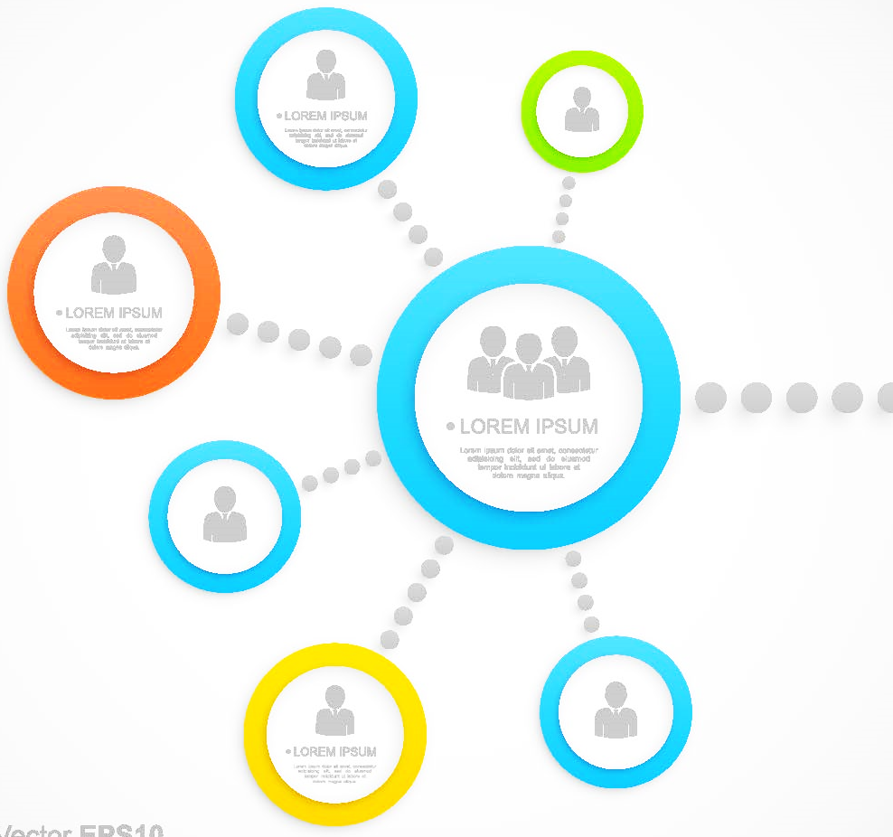
VA
Community Health Information Collaborative, Minnesota (not active)
Conemaugh, Pennsylvania
Hawaii Pacific Health, Hawaii
HealtheConnections, New York
Inland Northwest Health Services (INHS), Idaho
Indiana Health Information Exchange, Indiana
Kaiser Permanente, Southern California
Med Virginia, Virginia
MultiCare, Washington
Pensacola Health Information Exchange, Florida
San Diego Beacon, California
South Carolina Health Information Exchange, South Carolina
University of California Davis, California
Utah Health Information Network, Utah
Walgreens Retail Pharmacy (VISN 8 Pilot), Florida
Western New York HealtheLink, New York
Notes:
Move to handout?
Fully on-boarded non-VA partners

Slide 56
Current Partner
Notes:
Already outdated – last week VA announced 6 partners
HealtheConnections – Central NY
Gunderson Health System – LaCrosse, WI
Texas Health Resources – Dallas, TX
Lancaster General Health – Lancaster, PA
Oregon Community HIN
Sentara Healthcare – Hampton Roads, VA
*******
Community Health Information Collaborative, Minnesota (not active)
Conemaugh, Pennsylvania
Hawaii Pacific Health, Hawaii
HealtheConnections, New York
Inland Northwest Health Services (INHS), Idaho
Indiana Health Information Exchange, Indiana
Kaiser Permanente, Southern California
Med Virginia, Virginia
MultiCare, Washington
Pensacola Health Information Exchange, Florida
San Diego Beacon, California
South Carolina Health Information Exchange, South Carolina
University of California Davis, California
Utah Health Information Network, Utah
Walgreens Retail Pharmacy (VISN 8 Pilot), Florida

Slide 57
Current Partner
Testing Partner
Notes:
Allina Health, Minnesota
Department of Defense, Virginia
Dignity Health, California
East Tennessee Health Information Network (HIN), Tennessee
Gundersen Health Systems, Wisconsin
Health Information Exchange (HIE) Texas- Houston, Texas
HIE Texas, Texas
Lancaster General Health, Pennsylvania
Maine HealthInfoNet, Maine
Medical University of South Carolina, South Carolina
MetroHealth System, Ohio
Michigan HIN, Michigan
Mount Sinai Medical Center, Florida
Novant Health, North Carolina
Oregon Community Health Information Network (OCHIN), Nationwide
Oregon Health Sciences University, Oregon
Presbyterian Healthcare, New Mexico
Redwood Mednet, California
Sentara Healthcare, Virginia
Texas Health Resources, Texas
Unity Point Health, Iowa
University of Wisconsin Health, Wisconsin
Yale New Haven Health System, Connecticut
Aegis Developers Integration Lab (DIL) 2210 Gateway, Virginia
Aegis DIL 2211 Gateway, Virginia
JPT Formal Development Environment- DTC Zone A
JPT Formal DT&E Environment- DTC Zone A
JPT Formal Development Environment at ManTech

Slide 58
Current Partner
Testing Partner
28 Pending Partners
Notes:
We also have 28 pending partners who are ready to exchange with VLER Health upon planned software and specification enhancements!

Slide 59
Non-VA Provider
VLER Health Exchange
VLER Health Direct
Notes:
Now we’re going to switch gears and take a look at the other …
VLER Health Direct – allows one VA provider to send specific information to one non-VA provider (point to point) via email
*******

Slide 60

What is Direct Secure Messaging?

Slide 61
Direct Secure Messaging
secure email-like service
VA users send and receive encrypted health information with non-VA partners

Slide 62

How will VA use Direct?

Slide 63
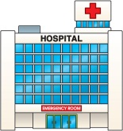

VA Uses of VLER Health Direct Secure Messaging
      Provider-to-provider messaging
      Veteran-initiated messaging
Notes:
Initial high-level VLER Health Direct Secure Messaging Uses:
Provider-to-provider messaging
VA and non-VA collaborative exchange of Veterans’ health information
Veteran-initiated messaging
Veterans sending their health summary through My HealtheVet Blue Button
*******

Slide 64

Why Use Direct?

Slide 65
Simple and secure
Greater workflow efficiencies
Meaningful Use 2014 Certification
National adoption
Well-established Internet standards
Notes:
Direct leads to greater workflow efficiencies by providing a low cost alternative to faxing and scanning
Direct is a simple and secure way to send messages and medical information to other providers, enhancing VHA clinicians ability to collaborate for Veteran patient care
Direct is required for Meaningful Use 2014 Certification which is facilitating national adoption
Direct is built on well-established Internet standards, commonly used for secure email communications
*******

Slide 66
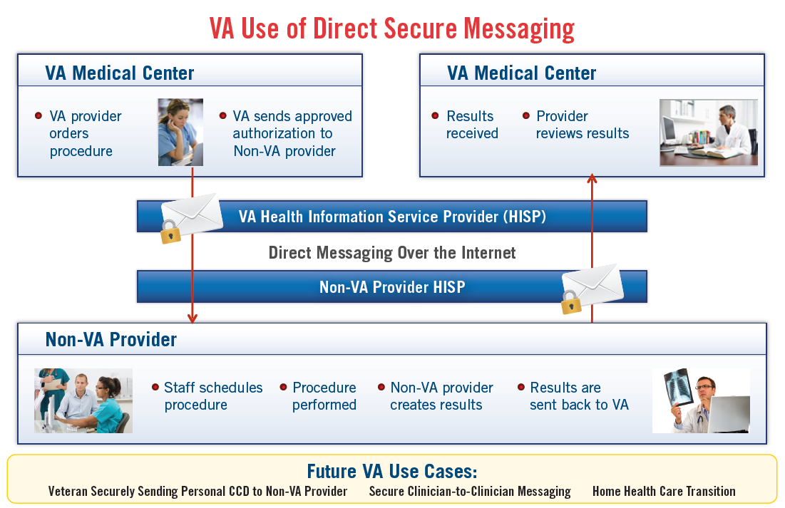
Notes:
Simple sample workflow for a referral
Over 20 million referrals in FY12
How does Direct fit with PC3 (Patient Centered Care Coordination)?
*******

Slide 67


Slide 68
What non-VA partners can VA users send Direct messages to?
How can my
community partners begin exchanging Direct messages with VA?
Non-VA
VA

Slide 69

Establishing
Direct Partnerships
Notes:
VA must establish a Direct partnership with the non-VA HISP prior to sharing messages – NO messaging without a trust relationship
Once established, messaging with entire HISP
The national VA Direct team works with non-VA partners to establish the partnerships.
Non-VA partners will need to get their own Direct address. This is often done through:
A Health Information Exchange (HIE)
A Electronic Health Record (EHR) vendor
A Direct messaging vendor
*******

Slide 70
How does VA plan to expand use of Direct?

Slide 71
available to anyone who wants it
Notes:
Goal:
8 partnerships in FY14
Another 50 in the FY15
Direct can be available to anyone throughout the United States
VA plans to establish Direct partnerships will all who want them.
You won’t need to ask (just like email or fax)
*******

Slide 72
What application is used for VA Direct messaging?
Can I use MS Outlook and my va.gov email address for Direct?

Slide 73
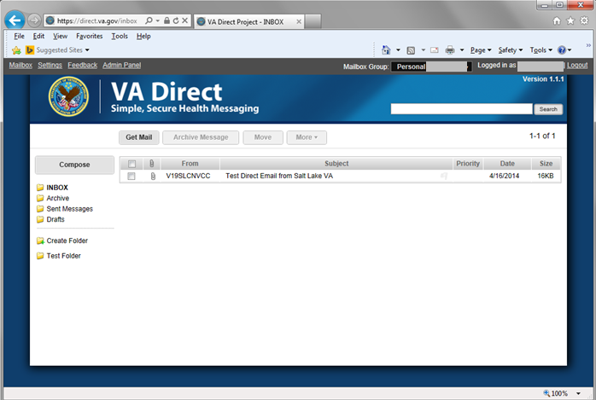
VLER Health Direct’s basic functionality is similar to many webmail portals
Notes:
VA Direct Web Portal- As Easy as Email
Accessed through PIV, separate login – Not Ideal
Bring into workflow - DaaS
*******

Slide 74

How can Veterans use Direct?

Slide 75
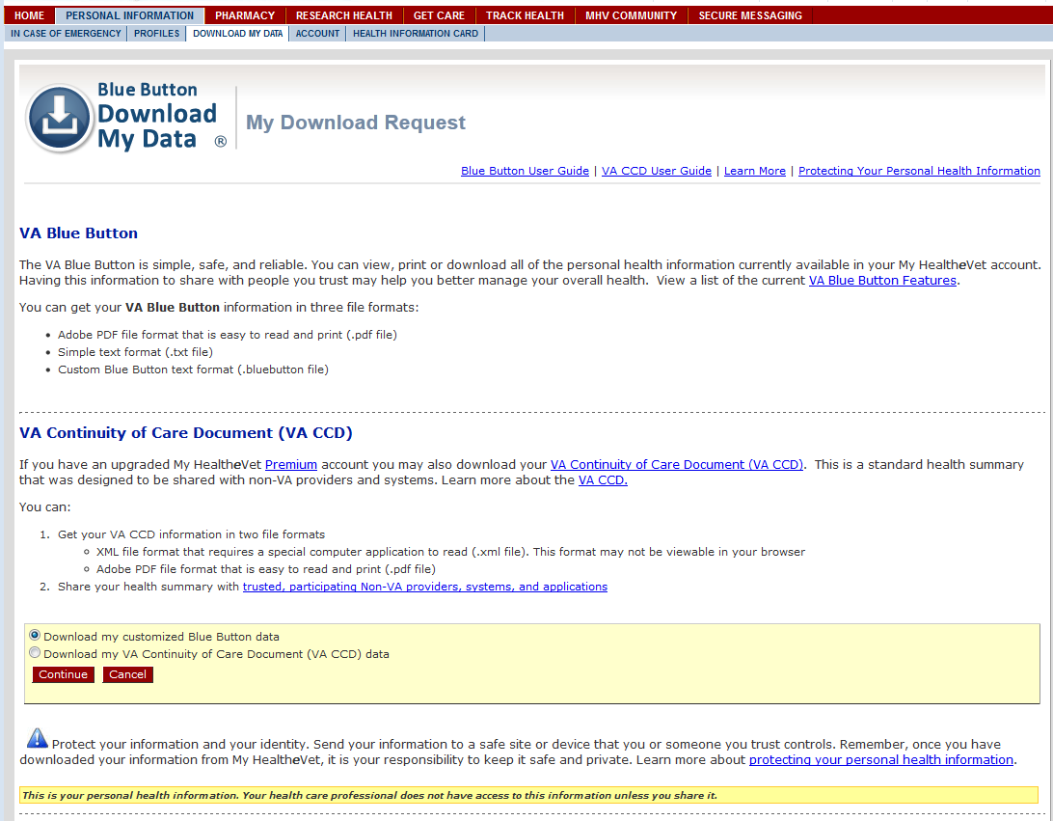
Sending a CCD using Direct
Access MyHealtheVet Blue Button

Slide 76
Sending a CCD using Direct
Select the CCD alternative

Slide 77
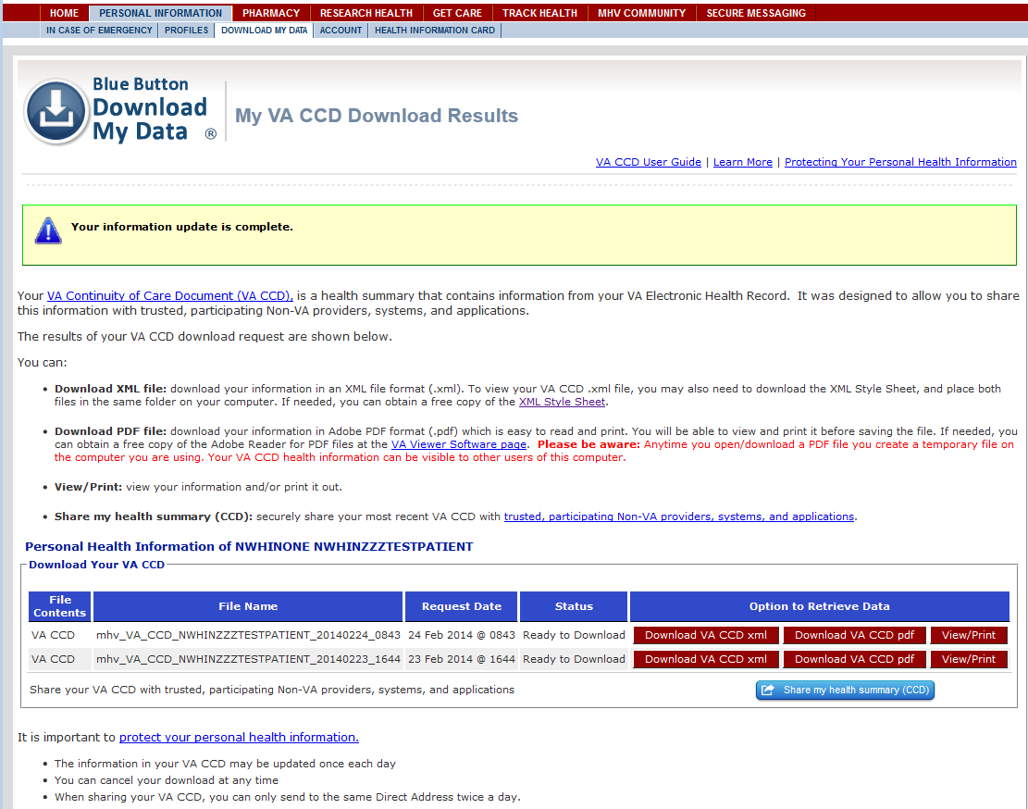
Sending a CCD using Direct
Share your data

Slide 78
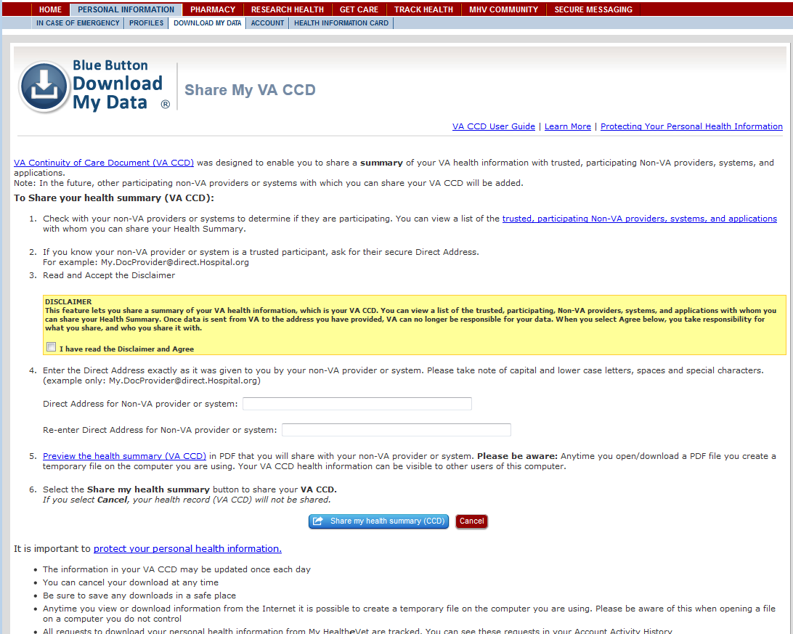
Sending a CCD using Direct

Slide 79
Sending a CCD using Direct
Check the box

Slide 80
Sending a CCD using Direct
Check the box
Enter email address
The user selects the button to share their data.

Slide 81
Sending a CCD using Direct
Check the box
Enter email address
Share your data

Slide 82
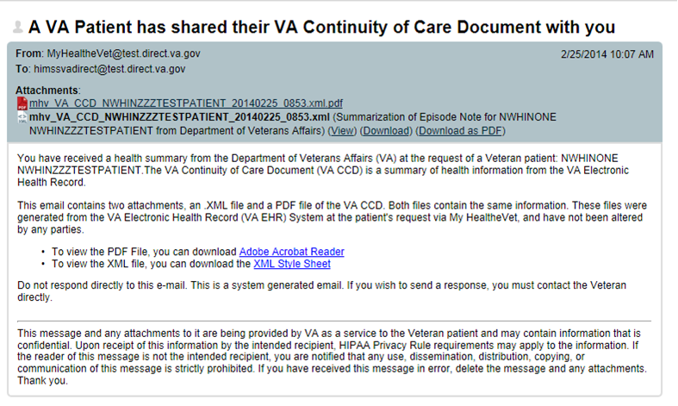
Sending a CCD using Direct
The provider is notified when the CCD was sent
Notes:
Veterans do not get VA Direct address
Can’t add/change content
This will take time to grow
Need trust relationships, know end users Direct address
*******

Slide 83

How does Direct
compare with
My HealtheVet (MHV)
Secure Messaging?

Slide 84


My HealtheVet Secure Messaging
VA Care Team
Veteran
Direct Secure Messaging
VA provider or Veteran
Non-VA Provider

Slide 85

How do I know Direct is secure?
Notes:
VA Direct Secure Messaging was developed using the Office of the National Coordinator’s (ONC) standards
Simple Mail Transfer Protocol (SMTP) for transport and Secure/Multipurpose Internet Mail Extensions and X.509 certificates for encryption and integrity protection
VA partner certificate must be cross-certified with the Federal Bridge Certificate Authority (FBCA). Users must be “Identity Proofed” at NIST Level of Assurance 3
VLER Health Direct Secure Messaging complies
VA Directive 6500 and VA Handbook 6500 relating to VA security,
Health Insurance Portability and Accountability Act (HIPAA) Final Security Rule
*******

Slide 86

Trust Framework
Notes:
A set of technical, legal, and business standards, expressed as policies and best practices recommendations, which members of the trust community agree to follow, uphold, and enforce.
*******

Slide 87
@
How can a VA employee get a Direct address?

Slide 88
@direct.va.gov
Notes:
In the pilot phase, Direct addresses will be provided to support specific uses with non-VA Direct partners
Eventually, Direct addresses will be available for all VA employees
Direct addresses are just like regular VA email addresses except it has “direct” after the @
Example: va.user4@direct.va.gov
*******

Slide 89

How can my VA facility begin using Direct?
What should we do to prepare?

Slide 90

Preparation
Notes:
Identify specific uses of Direct
Find out Direct capabilities of non-VA partners
Contact the Direct team to share interest
Note: Establishing Direct partnerships nationwide will be a several year process. Identifying the local need and ready partners will help in prioritization.
*******

Slide 91
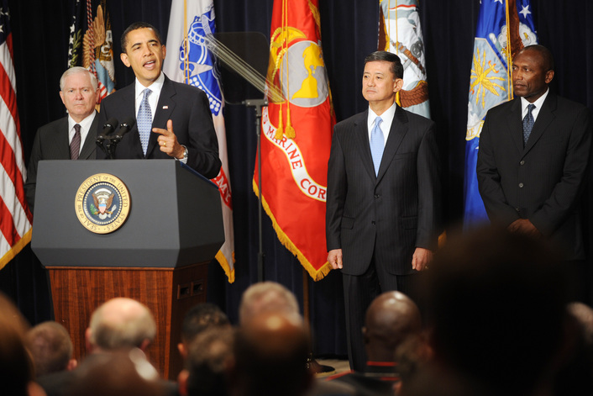
The Virtual Lifetime Electronic Record (VLER)…
“… will ultimately contain administrative and medical information from the day an individual enters military service throughout their military career and after they leave the military.”
-President Barack Obama
Notes:
Summary Slide
President Obama when introducing VLER in 2009
VLER Health using tools of Exchange and Direct play an important part in making the President’s vision a reality
*******

Slide 92

Ask the Presenter
Notes:
If you haven’t submitted your questions yet, there is still time to do so by clicking on the orange “Ask The Presenter” icon. We’re going to show a brief announcement and be right back to answer your questions.
(Stand still and smile until you see the video come up full screen)

